Slide 1
PACMAN
Contributors:
Hồ Đặng Phương Ngọc
Nguyễn Hoàng Phiên
Diệp Phương Quỳnh
Trần Tô Quế Phương

Slide 2
CONTENTS
Introduction
Requirements
Objectives
Diagram/UML
Features
References

Slide 3
INTRODUCTION
Pacman is a legendary game with an enthusiastic following from around the world
Your object is to help Pacman avoid the monsters and rid the screen of dots. When Pacman eats an energizer, the monsters are rendered harmless and turn dark blue. Now it's Pacman's turn to eat them and earn points.

Slide 4
REQUIREMENTS
Language : Java
Librabries : Swing, awt, io
Application Software : Eclipse, GitDesktop

Slide 5
OBJECTIVE
The application of Polymorphism, Inheritance, Generic,..
Have a good design patterns and follows solid
The uses of BFS
The uses of Algorithm

Slide 6
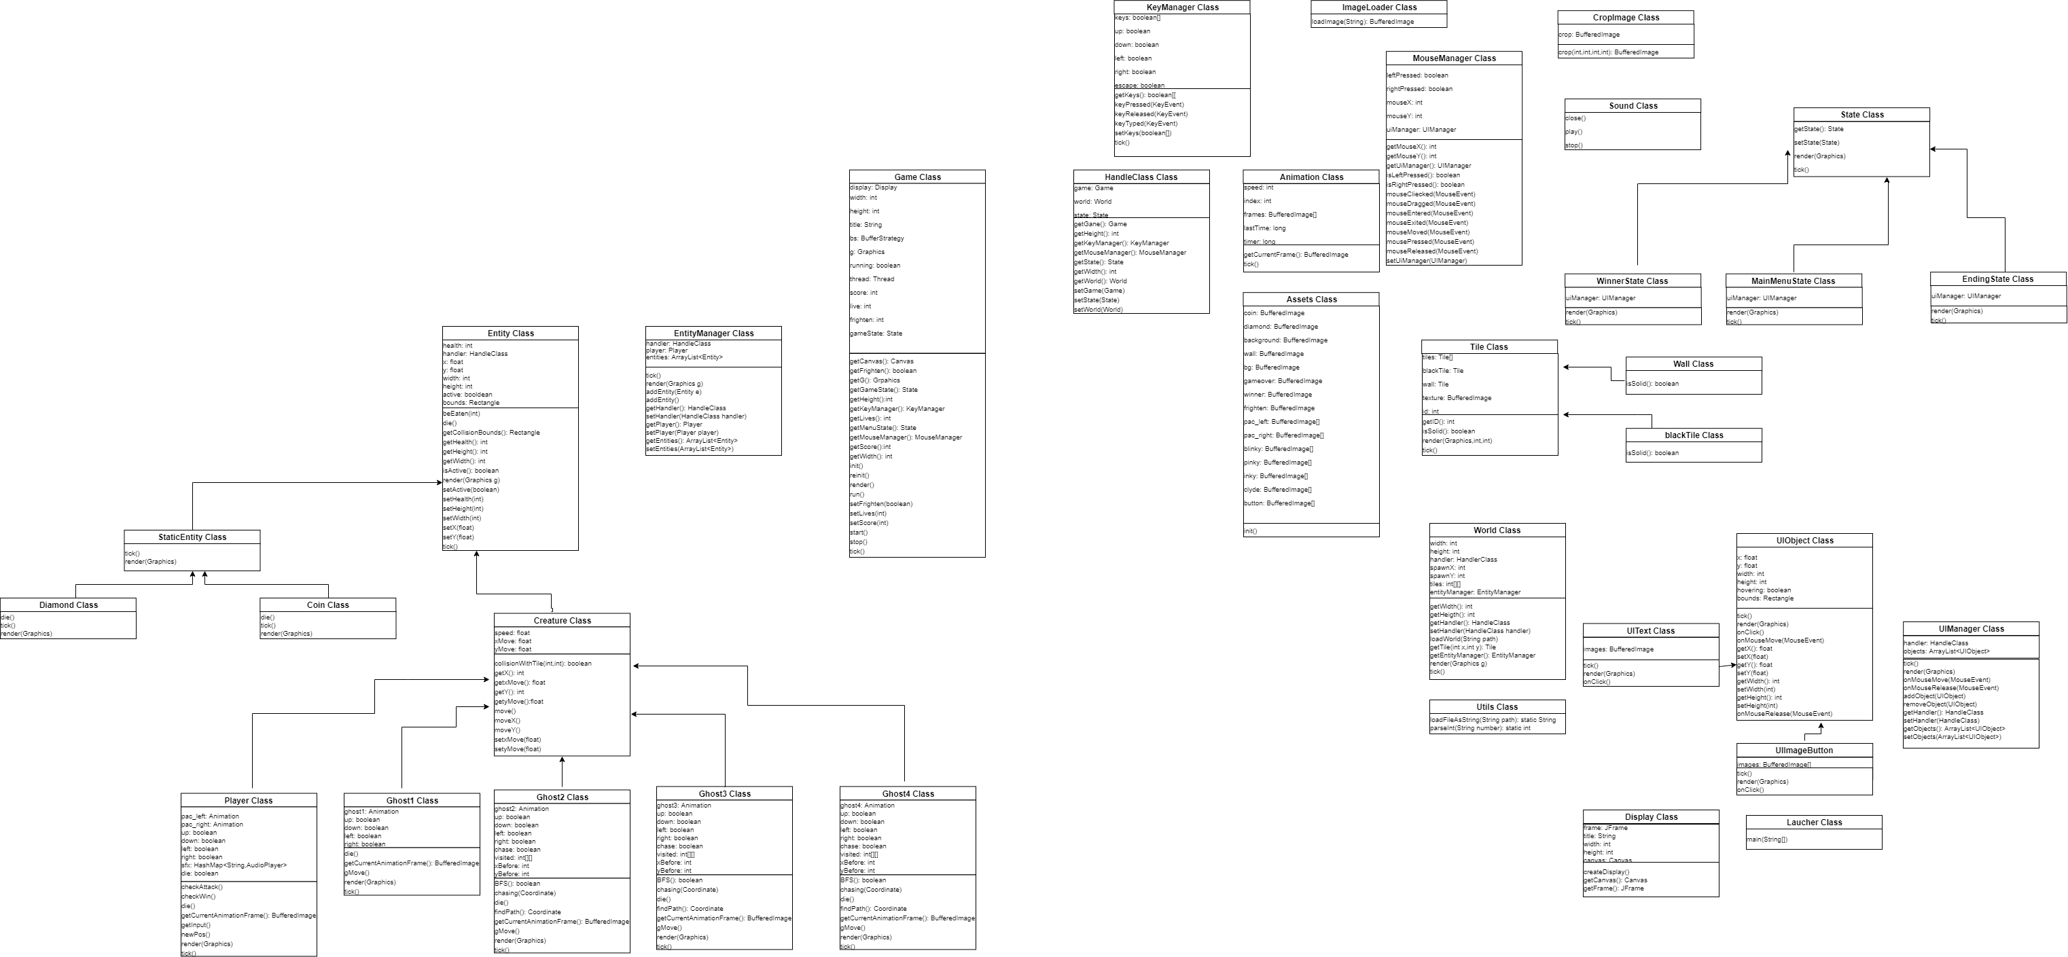
Diagram/UML

Slide 7
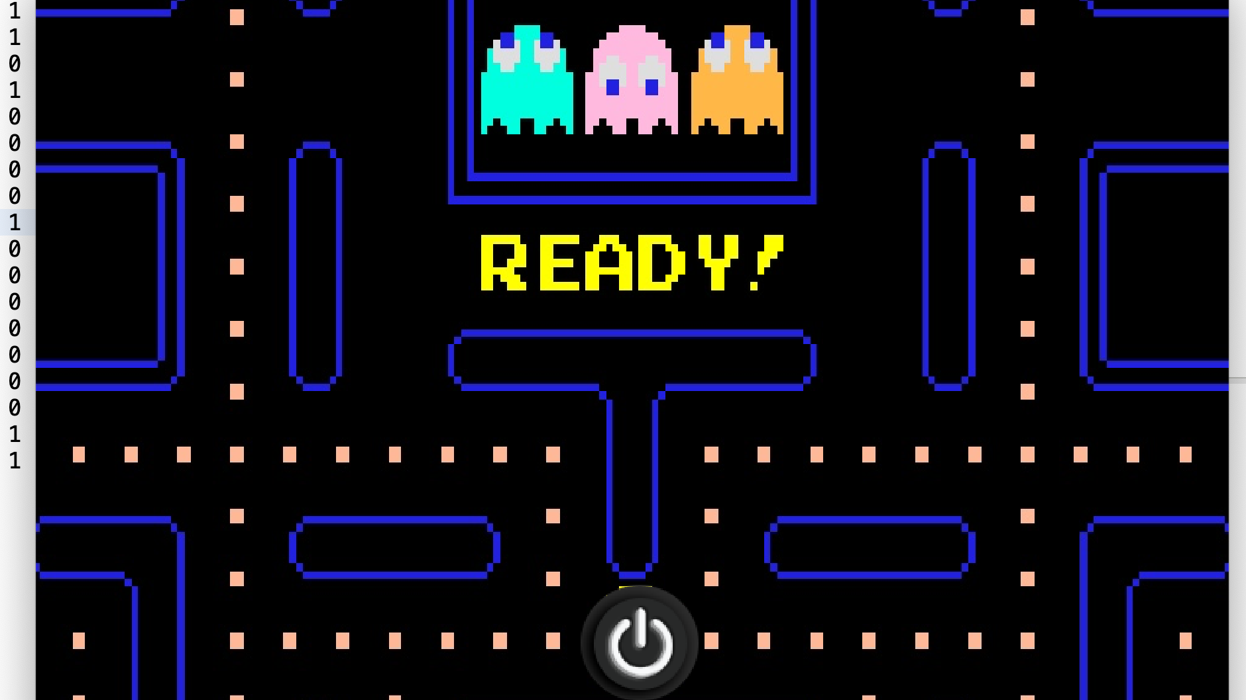


Slide 8
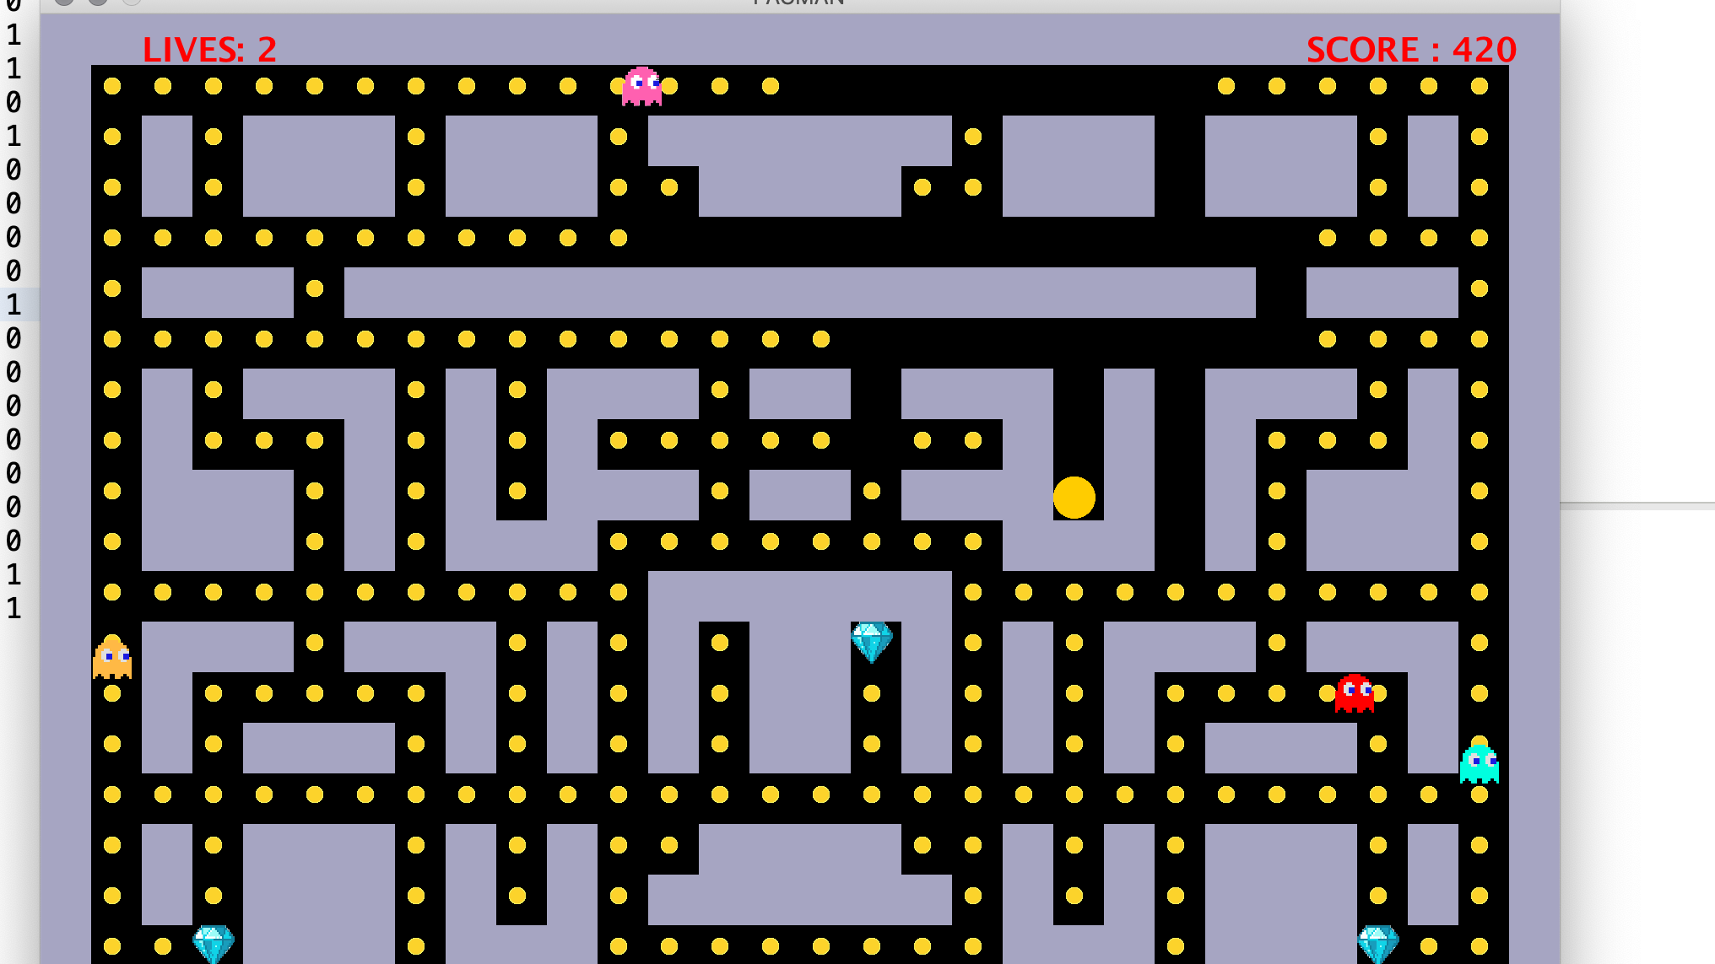

Slide 9
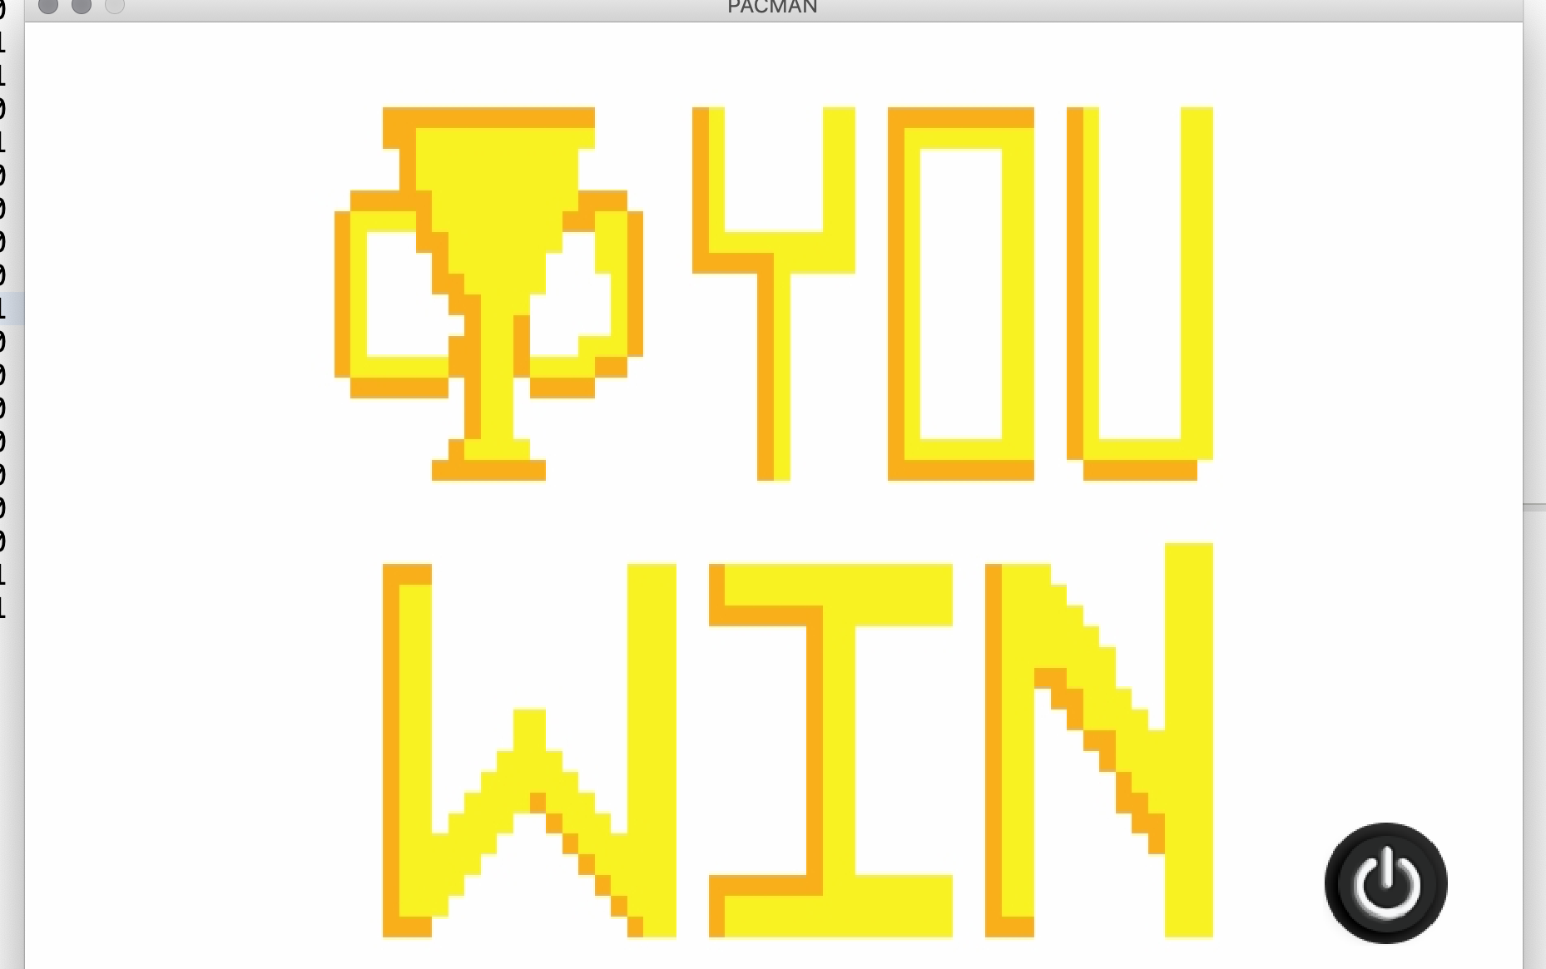


Slide 10
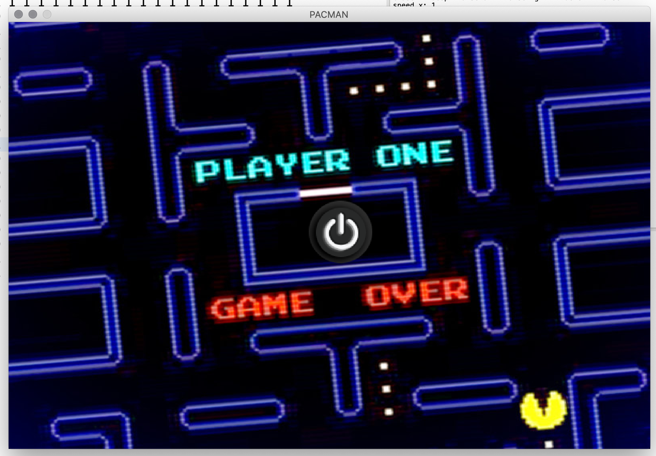

Slide 11
FEATURES
Button: Start, W-A-S-D
Eat Coin
Game Over (Pacman die)
Ghost Die
Get Score
Ghost run (BFS implementation)
Pacman run
Special Diamond
Revival

Slide 12
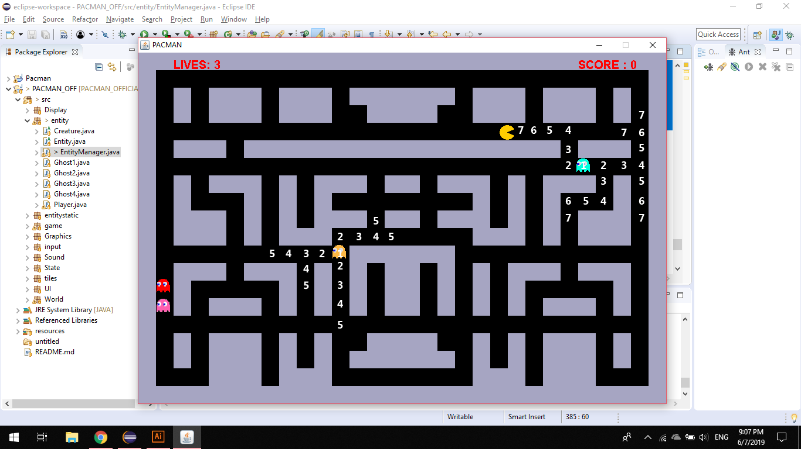
EXPLANATION
Consider the path from the Ghost to Pacman as a graph.
Every blacktile is a vertex.
Set all vertices visited=0.
Because ghost move randomly, we have to tick new position of the ghost to update
the path so we add it into a queue.
Tick position of the ghost visited[x][y]=1.
Into the while loop:
Set Coordinate s= queue.poll();
If s.y>0 and upper tile = blacktile and visited of the tile = 0 , add its coordinate
into queue and set its visited = visited[s.x][s.y]+1.
Similar for 3 other directions.
findPath() method check position of pacman.
If the path is less than a constant which we set for the ghost inky 7, clyde 10, pinky 5,
the ghost chases pacman.
Else it moves randomly as blinky.

Slide 13
REFERENCES
1. The You Tube series guiding to create simple 2D game
https://www.youtube.com/playlist?list=PLah6faXAgguMnTBs3JnEJY0shAc18XYQZ
2.
https://en.wikipedia.org/wiki/Pac-Man
3.
https://stackoverflow.com/questions/29141501/how-to-implement-bfs-algorithm-for-pacman
4.
https://www.hackerrank.com/challenges/pacman-bfs

